Slide 1
Diffusion SDEs

Slide 2
Overview
What is SDEs (ODEs) in Diffusion?
Learning-DiffusionSDEs Introduction.
Denoising Diffusion Probability Models (DDPMs).
Formulations and Proof
Recent Significant Work.
Diffusion in Generative Tasks.
Image
Music
Audio
Diffusion in 3D
Point Cloud
SDF

Slide 3
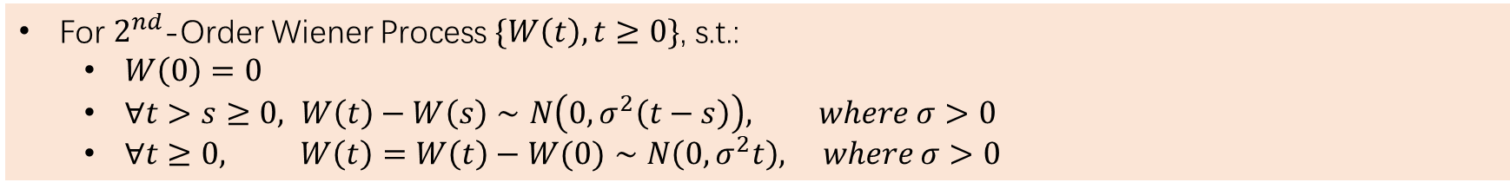
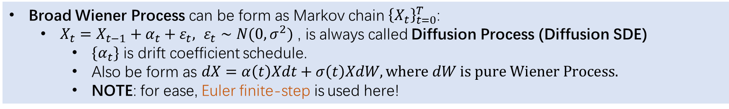
What is SDEs (ODEs) in Diffusion?
Wiener Process (Force on Diffusion Process)
For $2^{nd}$-Order Wiener Process $\{W\left(t\right),t≥0\}$, s.t.:
$W\left(0\right)=0$
$∀t>s≥0, W\left(t\right)−W\left(s\right)∼N\left(0,σ^{2}\left(t−s\right)\right), where σ>0$
$∀t≥0, W\left(t\right)=W\left(t\right)−W(0)∼N\left(0,σ^{2}t\right), where σ>0$
Broad Wiener Process can be form as Markov chain ${\left\{X_{t}\right\}}_{t=0}^{T}$:
$X_{t}=X_{t−1}+α_{t}+ε_{t}, ε_{t}∼N(0,σ^{2})$ , is always called Diffusion Process (Diffusion SDE)
$\{α_{t}\}$ is drift coefficient schedule.
Also be form as $dX=α\left(t\right)Xdt+σ\left(t\right)XdW, where dW is pure Wiener Process.$
NOTE: for ease, Euler finite-step is used here!
Note. Here Diffusion SDE is only a mathematical concept.
About $1^{st}$ finite-step. Following works contains $2^{nd}$ and implicit improvements.

Slide 4
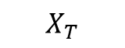
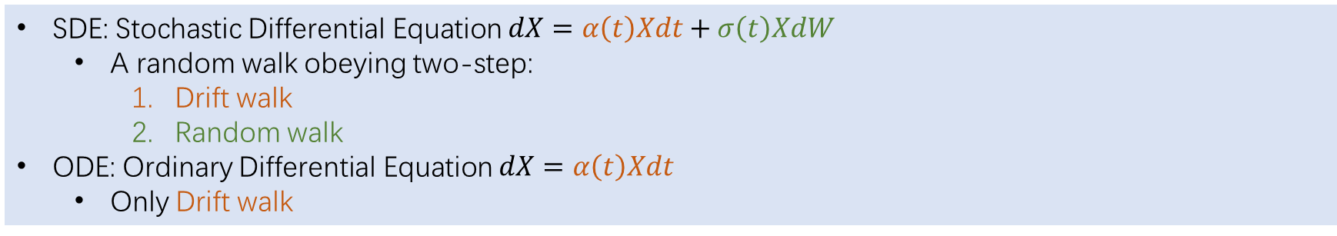
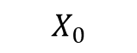
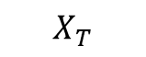
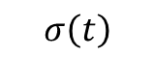
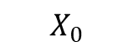
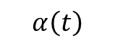
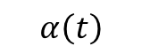
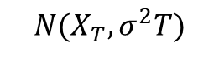
What is SDEs (ODEs) in Diffusion?
SDE and ODE definitions (following Diffusion SDE)
SDE: Stochastic Differential Equation $dX=α\left(t\right)Xdt+σ\left(t\right)XdW$
A random walk obeying two-step:
Drift walk
Random walk
ODE: Ordinary Differential Equation $dX=α\left(t\right)Xdt$
Only Drift walk
SDE
ODE
$$σ\left(t\right)$$
$$X_{T}$$
$$X_{0}$$
$$α\left(t\right)$$
$$X_{0}$$
$$X_{T}$$
$$α\left(t\right)$$
$$N(X_{T},σ^{2}T)$$
NOTE: This ODE definition is only a simple background knowledge.

Slide 5
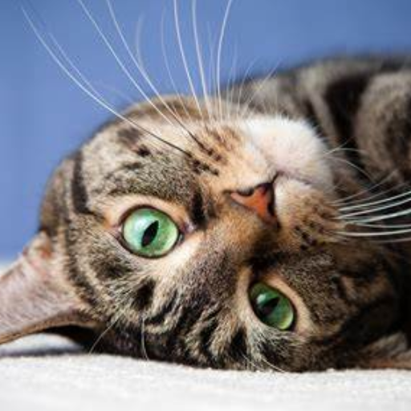
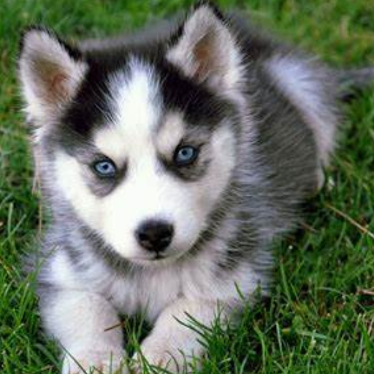
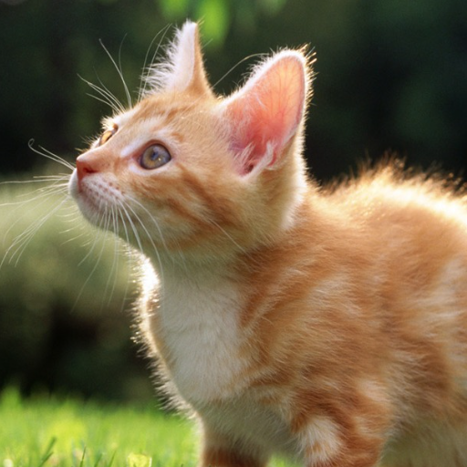
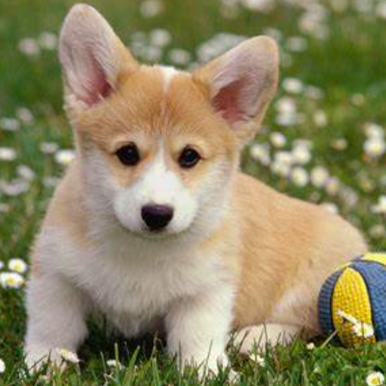
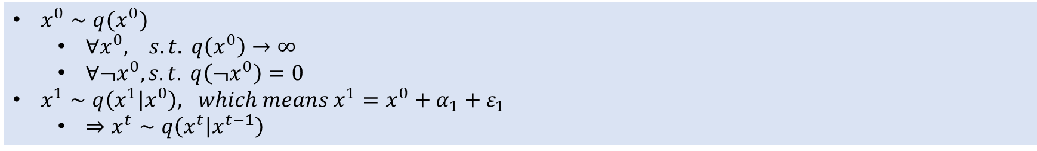
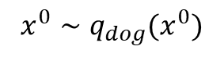
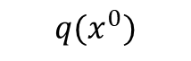
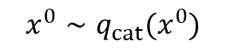
Learning-DiffusionSDEs Introduction
Conditional Distribution (for data, i.e. image)
$x^{0}∼q(x^{0})$
$∀x^{0}, s.t. q\left(x^{0}\right)→∞$
$∀¬x^{0}, s.t. q\left(¬x^{0}\right)=0$
$x^{1}∼q\left(x^{1} | x^{0}\right), which means x^{1}=x^{0}+α_{1}+ε_{1}$
$⇒x^{t}∼q\left(x^{t} | x^{t−1}\right)$
$$x^{0}∼q_{cat}(x^{0})$$
Data Space
$$x^{0}∼q_{dog}(x^{0})$$
$$q(x^{0})$$

Slide 6

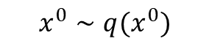
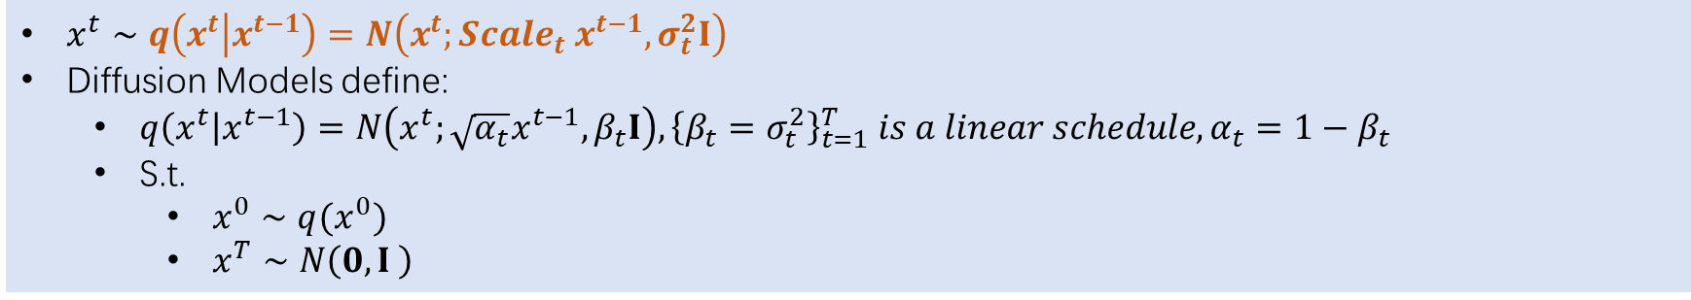
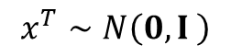
Learning-DiffusionSDEs Introduction
Forward Conditional Distribution (for data, i.e. image)
$x^{t}∼q\left(x^{t} | x^{t−1}\right)=N\left(x^{t};Scale_{t} x^{t−1},σ_{t}^{2}I\right)$
Diffusion Models define:
$q\left(x^{t} | x^{t−1}\right)=N\left(x^{t};\sqrt{α_{t}}x^{t−1},β_{t}I\right), {\left\{β_{t}=σ_{t}^{2}\right\}}_{t=1}^{T} is a linear schedule, α_{t}=1−β_{t}$
S.t.
$x^{0}∼q(x^{0})$
$x^{T}∼N\left(0,I \right)$
$$x^{0}∼q(x^{0})$$
Data Space
Noise Space
$$x^{T}∼N\left(0,I \right)$$
Diffusion SDE
Sohl-Dickstein, Jascha, et al. "Deep unsupervised learning using nonequilibrium thermodynamics." International conference on machine learning. PMLR, 2015.

Slide 7
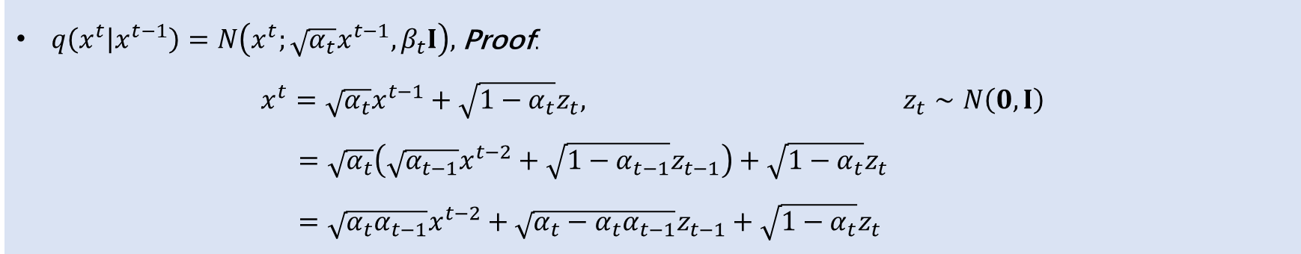

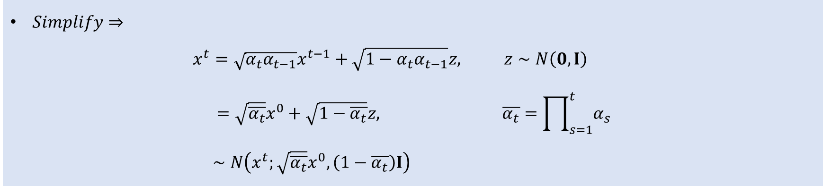
Learning-DiffusionSDEs Introduction
Forward Conditional Distribution (for data, i.e. image)
$q\left(x^{t} | x^{t−1}\right)=N\left(x^{t};\sqrt{α_{t}}x^{t−1},β_{t}I\right),$ Proof: $x^{t}=\sqrt{α_{t}}x^{t−1}+\sqrt{1−α_{t}}z_{t}, z_{t}∼N\left(0,I\right)$ $=\sqrt{α_{t}}\left(\sqrt{α_{t−1}}x^{t−2}+\sqrt{1−α_{t−1}}z_{t−1}\right)+\sqrt{1−α_{t}}z_{t}$ $=\sqrt{α_{t}α_{t−1}}x^{t−2}+\sqrt{α_{t}−α_{t}α_{t−1}}z_{t−1}+\sqrt{1−α_{t}}z_{t}$
$Lemma: If n_{1}∼N\left(μ_{1},σ_{1}^{2}\right) and n_{2}∼N\left(μ_{2},σ_{2}^{2}\right), ⇒ n_{1}+n_{2}∼N(μ_{1}+μ_{2},σ_{1}^{2}$+ $σ_{2}^{2})$
$Simplify⇒$ $x^{t}=\sqrt{α_{t}α_{t−1}}x^{t−1}+\sqrt{1−α_{t}α_{t−1}}z, z∼N\left(0,I\right)$ $=\sqrt{\overline{α_{t}}}x^{0}+\sqrt{1−\overline{α_{t}}}z, \overline{α_{t}}=\prod_{s=1}^{t}{α_{s}}$ $∼N\left(x^{t};\sqrt{\overline{α_{t}}}x^{0},\left(1−\overline{α_{t}}\right)I\right)$
$$∎$$
Sohl-Dickstein, Jascha, et al. "Deep unsupervised learning using nonequilibrium thermodynamics." International conference on machine learning. PMLR, 2015.

Slide 8
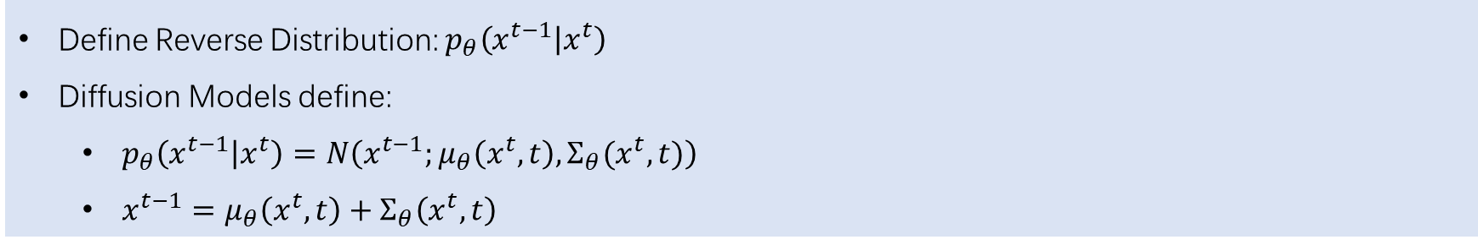
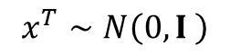
Learning-DiffusionSDEs Introduction
Reverse Conditional Distribution (for data, i.e. image)
Define Reverse Distribution: $p_{θ}\left(x^{t−1} | x^{t}\right)$
Diffusion Models define:
$p_{θ}\left(x^{t−1} | x^{t}\right)=N\left(x^{t−1};μ_{θ}\left(x^{t},t\right),Σ_{θ}(x^{t},t)\right)$
$x^{t−1}=μ_{θ}\left(x^{t},t\right)+Σ_{θ}\left(x^{t},t\right)$
$$x^{0}∼q(x^{0})$$
Data Space
Noise Space
$$x^{T}∼N\left(0,I \right)$$
How to reverse this process?
Sohl-Dickstein, Jascha, et al. "Deep unsupervised learning using nonequilibrium thermodynamics." International conference on machine learning. PMLR, 2015.

Slide 9
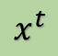
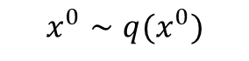
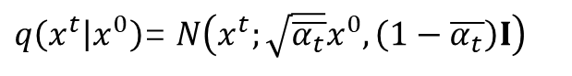


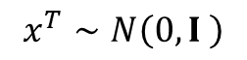
Learning-DiffusionSDEs Introduction
Form All (joint conditional distribution)
$q\left(x^{t} | x^{0}\right)$= $N\left(x^{t};\sqrt{\overline{α_{t}}}x^{0},\left(1−\overline{α_{t}}\right)I\right)$
$$q\left(x^{0:T} | x^{0}\right)=q(x^{0})\prod_{t=1}^{T}{q\left(x^{t} | x^{t−1}\right)}$$
$$x^{0}∼q(x^{0})$$
Train Network
$$x^{T}∼N\left(0,I \right)$$
$$x^{t}$$
Use Network to Predict
$$p_{θ}\left(x^{0:T} | x^{0}\right)=p(x^{T})\prod_{t=1}^{T}{p_{θ}\left(x^{t−1} | x^{t}\right)}$$
Sohl-Dickstein, Jascha, et al. "Deep unsupervised learning using nonequilibrium thermodynamics." International conference on machine learning. PMLR, 2015.

Slide 10
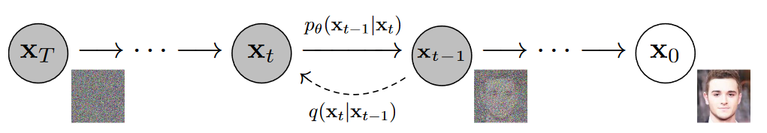
Denoising Diffusion Probability Models (DDPMs)
Primary Contributions
Answer what?
How to train Network? Why? a Training Target & Loss Function
How to Sample high quality $x^{0}$ from $x^{T}$? a Equivalence & Sampling Process
Overview:
Equivalence
Sampling Process
Training Target and Loss Function
Limitation and Recent Works
Network
Ho, J., Jain, A., & Abbeel, P. (2020). Denoising diffusion probabilistic models. Advances in neural information processing systems, 33, 6840-6851.

Slide 11
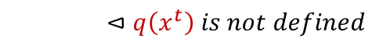
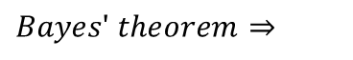
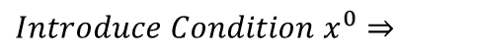
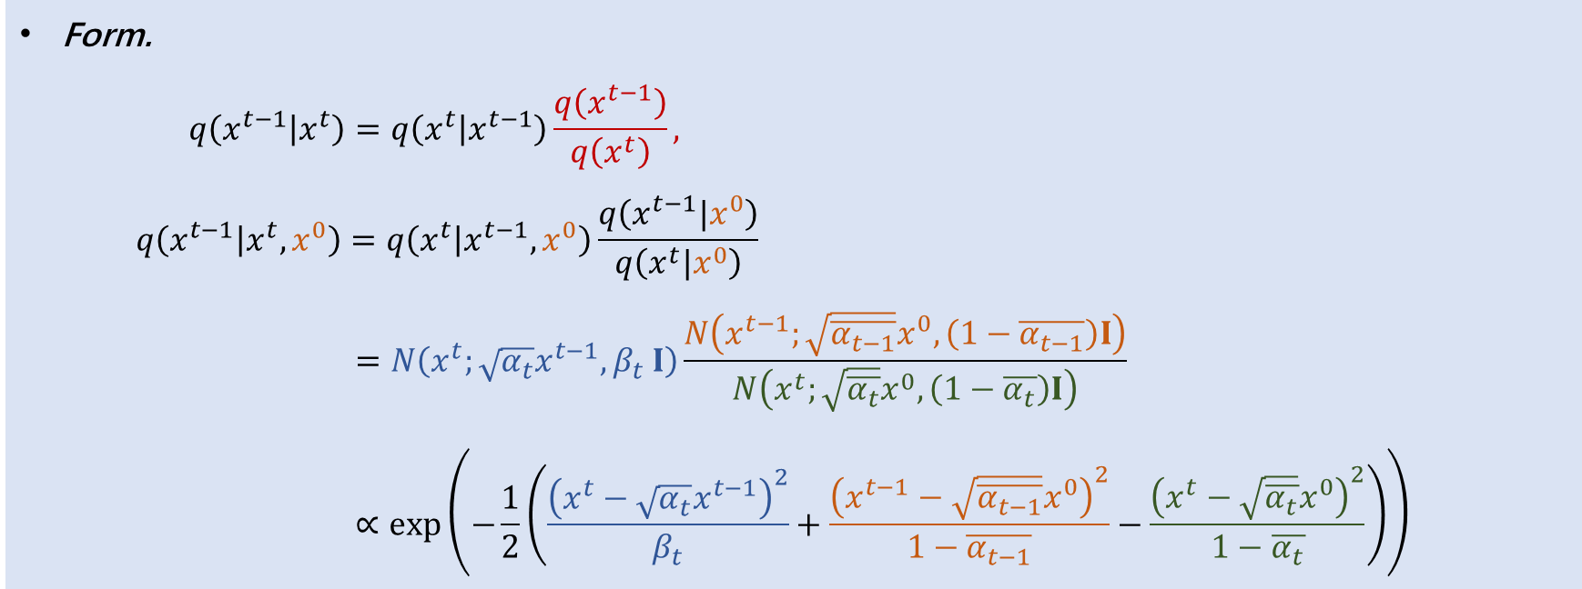
Denoising Diffusion Probability Models (DDPMs)
Equivalence
Equ what?
$p_{θ}\left(x^{t−1} | x^{t}\right)=N(x^{t−1};μ_{θ},Σ_{t})∝q\left(x^{t−1} | x^{t},x^{0}\right)=N(x^{t−1};\tilde{μ},\tilde{Σ})$
Form. $q\left(x^{t−1} | x^{t}\right)=q\left(x^{t} | x^{t−1}\right)\frac{q\left(x^{t−1}\right)}{q\left(x^{t}\right)},$ $q\left(x^{t−1} | x^{t},x^{0}\right)=q\left(x^{t} | x^{t−1},x^{0}\right)\frac{q\left(x^{t−1}|x^{0}\right)}{q\left(x^{t}|x^{0}\right)}$ $=N\left(x^{t};\sqrt{α_{t}}x^{t−1},β_{t} I\right)\frac{N\left(x^{t−1};\sqrt{\overline{α_{t−1}}}x^{0},\left(1−\overline{α_{t−1}}\right)I\right)}{N\left(x^{t};\sqrt{\overline{α_{t}}}x^{0},\left(1−\overline{α_{t}}\right)I\right)}$ $∝\exp\left(−\frac{1}{2}\left(\frac{{\left(x^{t}−\sqrt{α_{t}}x^{t−1}\right)}^{2}}{β_{t}}+\frac{{\left(x^{t−1}−\sqrt{\overline{α_{t−1}}}x^{0}\right)}^{2}}{1−\overline{α_{t−1}}}−\frac{{\left(x^{t}−\sqrt{\overline{α_{t}}}x^{0}\right)}^{2}}{1−\overline{α_{t}}}\right)\right)$
$$Bayes′ theorem⇒$$
$$⊲q\left(x^{t}\right) is not defined$$
$$Introduce Condition x^{0}⇒$$
Ho, J., Jain, A., & Abbeel, P. (2020). Denoising diffusion probabilistic models. Advances in neural information processing systems, 33, 6840-6851.

Slide 12
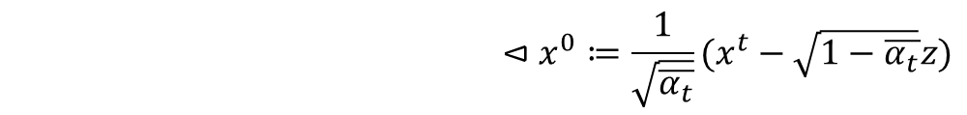
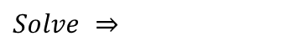

Denoising Diffusion Probability Models (DDPMs)
Equivalence
$$q\left(x^{t−1} | x^{t},x^{0}\right)∝\exp\left(−\frac{1}{2}\left(\frac{{\left(x^{t}−\sqrt{α_{t}}x^{t−1}\right)}^{2}}{β_{t}}+\frac{{\left(x^{t−1}−\sqrt{\overline{α_{t−1}}}x^{0}\right)}^{2}}{1−\overline{α_{t−1}}}−\frac{{\left(x^{t}−\sqrt{\overline{α_{t}}}x^{0}\right)}^{2}}{1−\overline{α_{t}}}\right)\right)$$
$Lemma: N\left(μ,σ^{2}\right)=\frac{1}{W\left(σ^{2}\right)}\exp\left(−\frac{{\left(x−μ\right)}^{2}}{{2σ}^{2}}\right)∝\exp\left(−\frac{1}{2}\left(\frac{1}{σ^{2}}x^{2}+2\frac{μ}{σ^{2}}x+\frac{μ^{2}}{σ^{2}}\right)\right)$
$$Solve ⇒$$
$$\tilde{Σ}=\frac{1−\overline{α_{t−1}}}{1−\overline{α_{t}}}β_{t} and \tilde{μ}=\frac{\sqrt{α_{t}}(1−\overline{α_{t−1}})}{1−\overline{α_{t}}}x^{t}+\frac{\sqrt{\overline{α_{t−1}}}β_{t}}{1−\overline{α_{t}}}x^{0} \\ \tilde{μ} ≔\frac{1}{\sqrt{α_{t}}}\left(x^{t}−\frac{β_{t}}{\sqrt{1−\overline{α_{t}}}}z\right),z∼N\left(0,I\right)$$
$$ReParameterizing (cite\left\{VAE\right\}) ⇒$$
$$⊲x^{0}≔\frac{1}{\sqrt{\overline{α_{t}}}}(x^{t}−\sqrt{1−\overline{α_{t}}}z)$$
Ho, J., Jain, A., & Abbeel, P. (2020). Denoising diffusion probabilistic models. Advances in neural information processing systems, 33, 6840-6851.

Slide 13
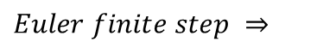

Denoising Diffusion Probability Models (DDPMs)
Equivalence
Equ what?
$p_{θ}\left(x^{t−1} | x^{t}\right)=N(x^{t−1};μ_{θ},Σ_{t})∝q\left(x^{t−1} | x^{t},x^{0}\right)=N(x^{t−1};\tilde{μ},\tilde{Σ})$
$$\tilde{Σ}=\frac{1−\overline{α_{t−1}}}{1−\overline{α_{t}}}β_{t} and \tilde{μ} ≔\frac{1}{\sqrt{α_{t}}}\left(x^{t}−\frac{β_{t}}{\sqrt{1−\overline{α_{t}}}}z\right), z∼N\left(0,I\right)$$
Sampling Process
$$Σ_{t}=\frac{1−\overline{α_{t−1}}}{1−\overline{α_{t}}}β_{t} and μ_{θ}=\frac{1}{\sqrt{α_{t}}}\left(x^{t}−\frac{β_{t}}{\sqrt{1−\overline{α_{t}}}}z_{θ}\left(x^{t}\right)\right)$$
$$Euler finite step ⇒$$
$$x^{t−1}=μ_{θ}+Σ_{t}z=\frac{1}{\sqrt{α_{t}}}\left(x^{t}−\frac{β_{t}}{\sqrt{1−\overline{α_{t}}}}z_{θ}\left(x^{t}\right)\right)+\frac{1−\overline{α_{t−1}}}{1−\overline{α_{t}}}β_{t}z, z∼N\left(0,I\right)$$
Ho, J., Jain, A., & Abbeel, P. (2020). Denoising diffusion probabilistic models. Advances in neural information processing systems, 33, 6840-6851.

Slide 14
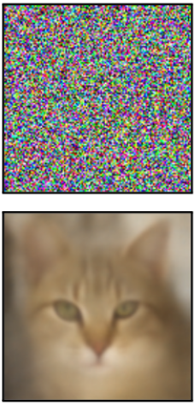
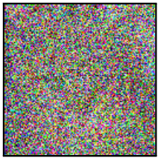
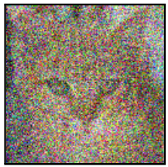
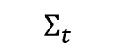

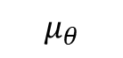
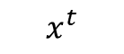
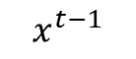
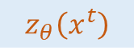
Denoising Diffusion Probability Models (DDPMs)
Sampling Process
$$x^{t−1}=\frac{1}{\sqrt{α_{t}}}\left(x^{t}−\frac{β_{t}}{\sqrt{1−\overline{α_{t}}}}z_{θ}\left(x^{t}\right)\right)+\frac{1−\overline{α_{t−1}}}{1−\overline{α_{t}}}β_{t}z, z∼N\left(0,I\right)$$
$$Σ_{t}$$
$$N\left(0,I\right)$$
$$z_{θ}\left(x^{t}\right)$$
+
$$x^{t}$$
$$μ_{θ}$$
$$x^{t−1}$$
About $1^{st}$ finite-step’s Error $O(∆x^{2})$. Proof via Taylor differential expansion.
Ho, J., Jain, A., & Abbeel, P. (2020). Denoising diffusion probabilistic models. Advances in neural information processing systems, 33, 6840-6851.

Slide 15
Denoising Diffusion Probability Models (DDPMs)
Training Target
$$x^{t−1}=\frac{1}{\sqrt{α_{t}}}\left(x^{t}−\frac{β_{t}}{\sqrt{1−\overline{α_{t}}}}z_{θ}\left(x^{t}\right)\right)+\frac{1−\overline{α_{t−1}}}{1−\overline{α_{t}}}β_{t}z, z∼N\left(0,I\right)$$
$$x^{t}={\sqrt{\overline{α_{t}}}x}^{0}+\sqrt{1−\overline{α_{t}}}z, z∼N\left(0,I\right)$$
Intuitively, Loss is:
$$ℒ=𝔼{\left\|{z−z}_{θ}\left(x^{t}\right)\right\|}^{d}$$
Ho, J., Jain, A., & Abbeel, P. (2020). Denoising diffusion probabilistic models. Advances in neural information processing systems, 33, 6840-6851.

Slide 16
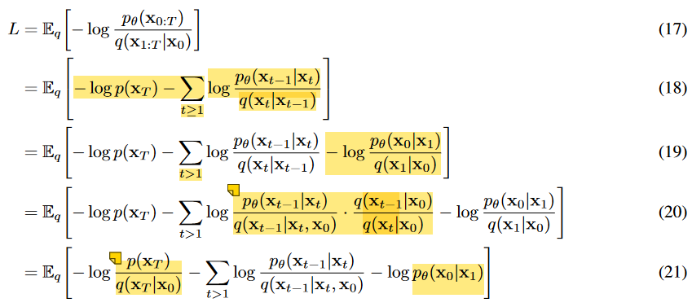
Denoising Diffusion Probability Models (DDPMs)
Loss Function
$$ℒ=𝔼{\left\|z−z_{θ}\left(x^{t}\right)\right\|}^{2}$$
Proof.
$$Usual Variational Bound on negative\log{likelihood}⇒$$
Ho, J., Jain, A., & Abbeel, P. (2020). Denoising diffusion probabilistic models. Advances in neural information processing systems, 33, 6840-6851.

Slide 17
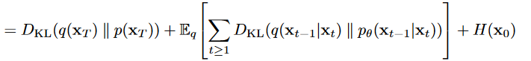
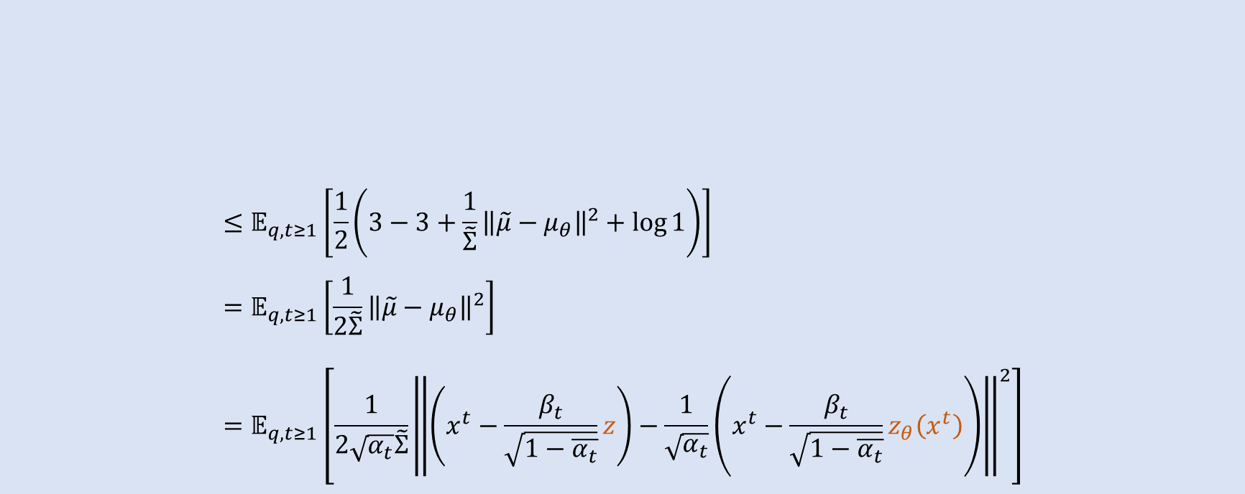
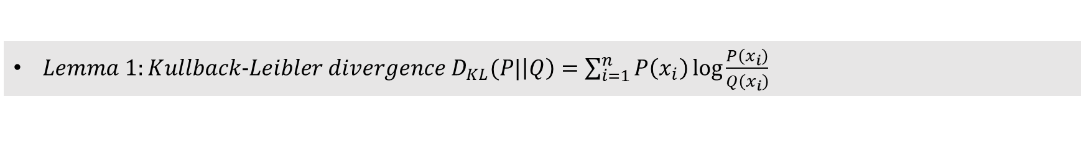
Denoising Diffusion Probability Models (DDPMs)
$Lemma 1:Kullback−Leibler divergence D_{KL}(P|\left|Q\right)=\sum_{i=1}^{n}{P\left(x_{i}\right)\log{\frac{P\left(x_{i}\right)}{Q\left(x_{i}\right)}}}$
$Lemma 2: D_{KL}(N_{0}|\left|N_{1}\right)=\frac{1}{2}\left(tr\left(Σ_{1}^{−1}Σ_{0}\right)−k+{\left(μ_{1}−μ_{0}\right)}^{T}Σ_{1}^{−1}\left(μ_{1}−μ_{0}\right)+\ln\left(\frac{\det{Σ_{1}}}{\det{Σ_{0}}}\right)\right)$
$$≤𝔼_{q,t≥1}\left[\frac{1}{2}\left(3−3+\frac{1}{\tilde{Σ}}{\left\|\tilde{μ}−μ_{θ}\right\|}^{2}+\log{1}\right)\right] \\ =𝔼_{q,t≥1}\left[\frac{1}{2\tilde{Σ}}{\left\|\tilde{μ}−μ_{θ}\right\|}^{2}\right] \\ =𝔼_{q,t≥1}\left[\frac{1}{2\sqrt{α_{t}}\tilde{Σ}}{\left\|\left(x^{t}−\frac{β_{t}}{\sqrt{1−\overline{α_{t}}}}z\right)−\frac{1}{\sqrt{α_{t}}}\left(x^{t}−\frac{β_{t}}{\sqrt{1−\overline{α_{t}}}}z_{θ}\left(x^{t}\right)\right)\right\|}^{2}\right]$$
$$Simplify⇒$$
Ho, J., Jain, A., & Abbeel, P. (2020). Denoising diffusion probabilistic models. Advances in neural information processing systems, 33, 6840-6851.

Slide 18

Denoising Diffusion Probability Models (DDPMs)
$$=𝔼_{q,t≥1}\left[\frac{1}{2\sqrt{α_{t}}\tilde{Σ}}{\left\|\left(x^{t}−\frac{β_{t}}{\sqrt{1−\overline{α_{t}}}}z\right)−\left(x^{t}−\frac{β_{t}}{\sqrt{1−\overline{α_{t}}}}z_{θ}\left(x^{t}\right)\right)\right\|}^{2}\right] \\ ≤𝔼_{q,t≥1}\left[{\left\|z−z_{θ}\left(x^{t}\right)\right\|}^{2}\right]=:ℒ_{simple}$$
$$∎$$
$$ℒ=𝔼{\left\|z−z_{θ}\left(x^{t}\right)\right\|}^{2}$$
Ho, J., Jain, A., & Abbeel, P. (2020). Denoising diffusion probabilistic models. Advances in neural information processing systems, 33, 6840-6851.

Slide 19


Denoising Diffusion Probability Models (DDPMs)
Limitations and Recent works
Euler finite step method $⇒$ Accumulated $O\left(x^{2}\right)$ error
Simi-implicit: Song et al. Denoising Diffusion Implicit Models
$2^{th}$ Order Simi-Euler: Nvidia et al. Elucidating the Design Space of Diffusion-Based Generative Models
SDEs depend on iterative generation process $⇒$ Slow sampling speed & caps potential for real-time
Probability flow ODEs: Song et al. Denoising Diffusion Implicit Models
Implicit ODEs: Song et al. Denoising Diffusion Implicit Models
EDM ODEs: Karras (Nvidia) et al. Elucidating the Design Space of Diffusion-Based Generative Models
※Consistency ODEs is all you need!: Song (Openai) et al. Consistency Models
Ho, J., Jain, A., & Abbeel, P. (2020). Denoising diffusion probabilistic models. Advances in neural information processing systems, 33, 6840-6851.

Slide 20






Denoising Diffusion Probability Models (DDPMs)
Limitations and Recent works
$q\left(x^{T}\right)∼N\left(0,I\right)⇒$ Rely on the prior distribution (Gaussian)
For all distribution: Heitz et al. Iterative 𝛼-(de)Blending: a Minimalist Deterministic Diffusion Model
Ho, J., Jain, A., & Abbeel, P. (2020). Denoising diffusion probabilistic models. Advances in neural information processing systems, 33, 6840-6851.

Slide 21



Denoising Diffusion Probability Models (DDPMs)
About Network
(Background) Why do they prefer U-Net?
Training target $z$ by U-Net is easy.
Smaller network, faster training.
Inserting semantic feature into trained U-Net can do something interesting.
Semantic Feature
Ho, J., Jain, A., & Abbeel, P. (2020). Denoising diffusion probabilistic models. Advances in neural information processing systems, 33, 6840-6851.

Slide 22
Applications

Slide 23







Text to Image Generation
LDMs
unCLIP (Openai)

Slide 24



Audio
WaveGrad
Symbolic Music Generation With Diffusion Models
Grad-TTS

Slide 25





Text to Image Generation
Imagen Video： High Definition Video Generation With Diffusion Models

Slide 26




3D Point Cloud Generation
(22 ACCV)A Diffusion-ReFinement Model for Sketch-to-Point Modeling

Slide 27




3D Point Cloud (Mesh) Generation
(22 NIPS Nvidia) LION: Latent Point Diffusion Models for 3D Shape Generation
Fuzz Latent Points
Fuzz Shape Latent
PVCNN: Point Voxel CNNs
SAP: Shape As Points

Slide 28







3D Grid (Field) Generation
(22 Sig) Neural Wavelet-domain Diffusion for 3D Shape Generation, Inversion, and Manipulation
Notes:
Manipulation 使用两个shape的小波做调和。

Slide 29




3D Grid (Field) Generation
(23 CVPR)Diffusion-SDF: Text-to-Shape via Voxelized Diffusion
Text-Guided Shape Completion
Text-Guided Shape Manipulation

Slide 30




3D Grid (Field) Generation
(23 Sig) Locally Attentional SDF Diffusion for Controllable 3D Shape Generation
Notes:
Manipulation 使用两个shape的小波做调和。

